Slide 1
STACK
DRUPAL 7 BASED
PHP 8.2
Dynamic
Form
Builder
Drupal 7
MySQL
Apache Solr 9
Memcache
REST WS
Survey management platform built on Drupal 7
WebSocket
5 CUSTOM MODULES
Tushar Luitel · 2025

Slide 2

OVERVIEW
Project Overview
5
12
11
Custom Modules
Question Types
Custom Permissions
STEP 1
STEP 2
STEP 3
STEP 4
Create Form
Share
Respond
Analyse
Admin builds form with sections & questions
→
Invite members by email or make public
→
Respondents fill form; drafts auto-save
→
View responses, filter via Solr, export
MODULES
dynamic_form
dynamic_form_response
dynamic_form_export
dynamic_form_analytics
dynamic_form_solr

Slide 3
SCHEMA
Database Schema
Tables use soft-delete via deleted_at
dynamic_form_forms
dynamic_form_responses
id, title, slug, status, visibility, question_per_page, opens_at, closes_at, allow_multiple_submissions
id, form_id, user_id, status (0=draft / 1=submitted), anonymous_email, submitted_at
dynamic_form_sections
dynamic_form_answers
id, form_id, name, description, position
id, response_id, question_id, value (text), created_at, updated_at
dynamic_form_questions
dynamic_form_answer_files
id, form_id, section_id, label, type, is_required, is_readonly, width, allow_file_types, max_file_size, max_files
id, answer_id, file_path, file_name, file_type, file_size
dynamic_form_question_options
dynamic_form_members
id, question_id, option_label, position, deleted_at
id, form_id, user_id, role (editor | form_applicant)
dynamic_form_question_validations
dynamic_form_invitations
id, question_id, rule_type, rule_value, error_message — also holds scale_min/max & allow_multiple
id, form_id, email, role, token, expires_at, invited_by
dynamic_form_tags
dynamic_form_audit_log
id, name (unique, normalised lowercase)
id, entity_type, entity_id, action, old_value (JSON), new_value (JSON), created_by

Slide 4
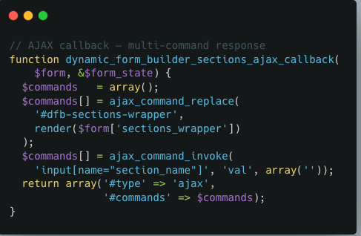
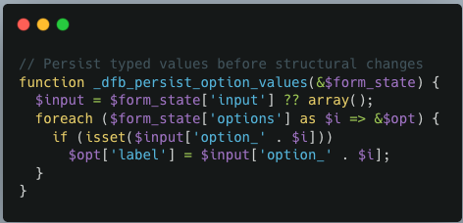
BUILDER
Form Builder Architecture — dynamic_form.builder.inc
1
Page Callback
Loads form via entity_get_controller()->loadSingle(). Injects JS settings (formId, wsUrl, HMAC token). Renders Sections Form + Question Modal.
2
Sections Form — AJAX Add-More
First load pulls sections from DB into $form_state['sections']. #limit_validation_errors on submit. Insert via entity controller → set $form_state['rebuild'] = TRUE.
3
Question Modal — 3 Zones
Type picker (fixed) → scrollable body → action footer. data-dfb-show-for drives JS visibility. _dfb_persist_option_values() preserves typed content on rebuild.
4
Edit Form + Reorder
Edit pre-populates from DB; type picker locked if form has responses. dynamic_form_ajax_reorder() batch-updates positions and invalidates the questions cache.

Slide 5
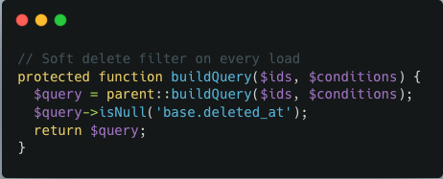
ENTITY LAYER
Entity Controller — DrupalDefaultEntityController
All 4 entity types extend DrupalDefaultEntityController. buildQuery() is overridden to always append ->isNull('base.deleted_at') — soft-deleted rows are invisible to entity_load() and the REST API without any caller changes.
4 REGISTERED ENTITY TYPES
dynamic_form_form
DynamicFormFormController
Method | What it does
create() | Cast array to object → drupal_write_record() → loadSingle() to return hydrated entity. Question create also invalidates questions cache.
update() | loadSingle → merge fields → drupal_write_record($tbl, $entity, ['id']) → resetCache() → re-load fresh.
softDelete() | db_update() sets deleted_at + deleted_by → resetCache(). Row survives in DB for audit trail.
dynamic_form_section
DynamicFormSectionController
dynamic_form_question
DynamicFormQuestionController
dynamic_form_question_option
DynamicFormQuestionOptionController
Registered in hook_entity_info() via the 'controller class' key. Called via entity_get_controller('type').
entity_get_controller
buildQuery
Database executes query
Returns only non-deleted entities

Slide 6
RESPONSE
Response Module — Submission Flow
AJAX LIFECYCLE
QUESTION TYPE → FAPI ELEMENT
Render Form
Sections + questions → steps via array_chunk() by question_per_page. Validation rules in data-validations JSON. Select2 / TinyMCE loaded only when needed.
text
→ textfield
textarea
→ textarea (rows=4)
Guest Token
text_editor
→ TinyMCE textarea
Anonymous visitors get a 64-char cryptographic cookie dfr_guest tied to their draft.
radio
→ expanded radio buttons
AJAX Save Draft
checkbox
→ expanded checkboxes
CSRF via drupal_valid_token(). First save: createDraft() + session row. Returns response_id. Tags & files routed to dedicated handlers.
select
→ Select2 widget
AJAX Submit
rating
→ star widget via theme()
Validates required fields + custom rules server-side. On success: submit() sets status=1, fires Solr indexing.
linear_scale
→ button widget via theme()
tags
→ Select2 + autocomplete
File Upload
Ext denylist (php, sh, exe…) + configurable allowlist + file_munge_filename() + Drupal managed file registration.
file
→ dropzone + managed file
date / time
→ HTML5 native inputs

Slide 7
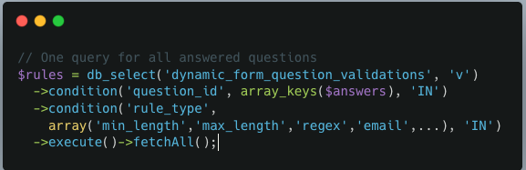
VALIDATION
Question Validation in the Response Layer
Storage — EAV in dynamic_form_question_validations
A single table stores user rules, scale meta (min/max/labels), and config flags (allow_multiple) discriminated by rule_type. Custom error_message per row; falls back to built-in default when empty.
Server-Side Rule Engine — _dynamic_form_response_apply_rule()
CLIENT-SIDE FLOW
rule_type | What it checks | Drupal API
min_length / max_length | Character count comparison | drupal_strlen()
min_value / max_value | Numeric float comparison | is_numeric() + cast
regex | Pattern match — backtrack limit capped at 10 000 (ReDoS guard) | preg_match()
email | Valid email address | valid_email_address()
url | Valid URL (http/https/ftp) | valid_url($v, [...])
numeric | Is a number | is_numeric()
Rules baked into HTML
data-validations='[{...}]' on wrapper. JS reads on blur; shows inline error without round-trip.
Required check
data-required="1" blocks next-step navigation. Server re-validates against getAnswersMap().
Server returns error map
{ status:'error', errors:{ qid: 'msg' } }. JS highlights each field by question ID.

Slide 8
EXPORT
Response Export — Drupal Batch API + OpenSpout
SINGLE FORM
BULK
BATCH PIPELINE
All responses for one form as one worksheet
Multiple forms — each gets its own worksheet in one .xlsx
START
_dynamic_form_export_responses_start_batch()
Why Batch API?
Validate form IDs · count responses · build operations array · call batch_set()
max_execution_time kills a naive loop on large exports.
Batch API breaks work into 200-response HTTP sub-requests.
OP 1 / FORM
Drupal handles the progress bar, error recovery, and result accumulation.
Init — create JSONL + write header row
Intermediate data written to a temp JSONL file per form. The Finished callback reads all JSONL files and assembles the final .xlsx via OpenSpout, then streams it to the browser.
Columns: Timestamp, Email, Respondent, Response ID, then one column per question
OP 2…N
Process — chunks of 200 responses
Fetch 200 responses + answers · append JSONL rows · update $context progress
FINISHED
Assemble .xlsx via OpenSpout → stream
Reads all JSONL temp files · one sheet per form · browser download

Slide 9
SEARCH
Apache Solr — dynamic_form_solr
Only module that knows Solr exists
HOOK-BASED INTEGRATION
SOLR DOCUMENT FIELD SCHEMA
Event / Hook | Solr Action
hook_dynamic_form_response_predelete | deleteById response-{id}
hook_dynamic_form_form_predelete | deleteByQuery is_form_id:{id}
After submit (direct call) | Index response document
hook_menu_alter() | Replace tags autocomplete with Solr-powered version transparently
Dynamic field prefixes auto-type via apachesolr schema — no manual schema.xml edits.
tm_q_{qid}
text / textarea / tags — tokenised, multi-valued, full-text + cross-field tm_answers
sm_q_{qid}
checkbox / select arrays — string exact, multi-valued, facetable
QUERY STRATEGY
ss_q_{qid}
Filter queries (fq) — cached per shard, very fast:
entity_type:dynamic_form_response | is_form_id:12
ds_submitted_at:[2025-01-01T00:00:00Z TO *]
(ss_q_5:"Yes" OR ss_q_5:"No") ← radio / single-value
Main query (q) — tokenised full-text:
tm_q_11:nepal* AND tm_q_14:budget*
Defaults to q=*:* when no text filter active
scalar answers (radio, date, rating) — string exact, single-valued
is_form_id / is_response_id
integer fields — exact match, fast bitset filtering
ds_submitted_at
ISO-8601 UTC — Solr date range queries

Slide 10
REST API
REST API — contrib restws Module
Method | Endpoint | Description
GET | /dynamic_form_form.json | Paginated list of forms
GET | /dynamic_form_form/{id}.json | Single form by ID
GET | /dynamic_form_section.json?parameters[form_id]=N | Sections for a form
GET | /dynamic_form_question/{id}.json | Single question
GET | /dynamic_form_question_option.json?parameters[question_id]=N | Options for a question
GET | /dynamic_form_response.json?parameters[form_id]=N | Responses for a form
GET | /dynamic_form_answer.json?parameters[response_id]=N | Answers for a response
HOW RESTWS WIRES TO ENTITIES
hook_entity_info()
Declares entity types with 'controller class' key. restws reads this to discover the base table and entity keys.
hook_entity_property_info()
Declares typed field metadata. restws serialises each field to JSON automatically.
hook_restws_resource_info_alter()
Replaces default controller with DynamicFormRestWSEntityResourceController so list/count queries also respect deleted_at IS NULL.
Read-Only by Design
All writes go through the form builder and response submission flows where CSRF protection, flood control, and business rules are enforced. Auth: HTTP Basic Auth.
Rate Limiting via flood_is_allowed() in hook_init()
60 requests / min per IP · 120 requests / min per authenticated user

Slide 11
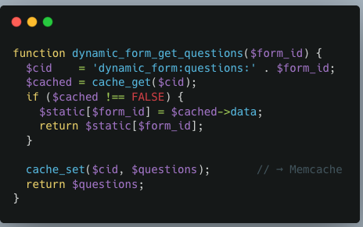
CACHING
Caching — Memcache + drupal_static()
CACHE STACK
DYNAMIC_FORM_GET_QUESTIONS() — ANNOTATED
Memcache via cache_get()
Cross-request persistence. Contrib Memcache module replaces Drupal's DB cache backend transparently. Key: dynamic_form:questions:{form_id}.
Invalidation
dynamic_form_invalidate_questions_cache($form_id) called on every question create, update, soft-delete, or reorder. Clears exact cache key + resets drupal_static.

Slide 12
REFACTOR
Last Week — Refactoring to Drupal 7 Patterns
● Before — Raw PHP / HTML
✓ After — Drupal 7 Way
— Builder page used raw db_select() for form load — no entity layer
✓ entity_get_controller('dynamic_form_form')->loadSingle($id)
— No involvement of Controllers
✓ Use of DrupalDefaultEntityController
— Inline HTML strings for section cards, modals, question cards
✓ All UI markup moved to theme() calls with .tpl.php in hook_theme()
— AJAX endpoints returned raw HTML fragments, not Drupal command arrays
✓ AJAX callbacks return structured command arrays: ajax_command_replace() etc.
— JS autocomplete used raw XMLHttpRequest instead of Drupal.behaviors
✓ Autocomplete uses Drupal.behaviors — safe attach, no double-init
— Missing flood control on AJAX endpoint — vulnerable to DDoS / abuse
✓ Flood control
drupal_write_record()
form_load_include()
drupal_valid_token()
Replaces raw INSERT/UPDATE — schema introspection + type coercion automatically
Ensures .inc files load during AJAX rebuilds via $form_state['build_info']['files'][]
CSRF protection on every AJAX POST endpoint — replaces ad-hoc nonce checking

Slide 13
Thank You

